Slide 1
CMN260 Novel Ideas
Tutorial Week 5: Metafiction

Slide 2
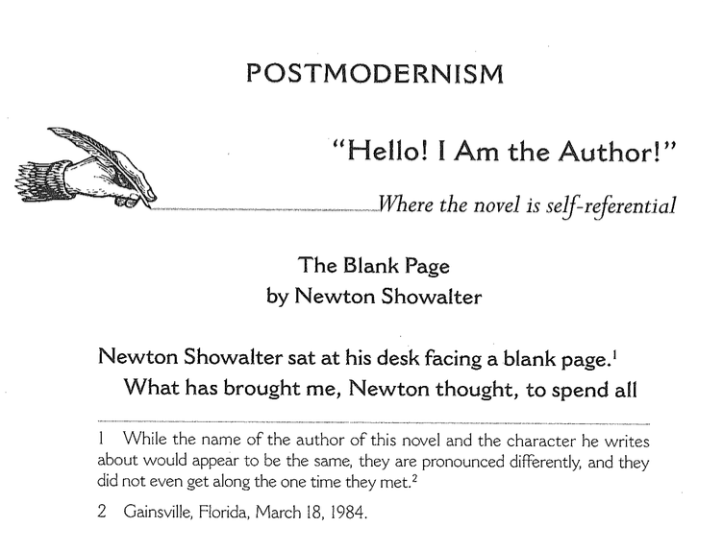
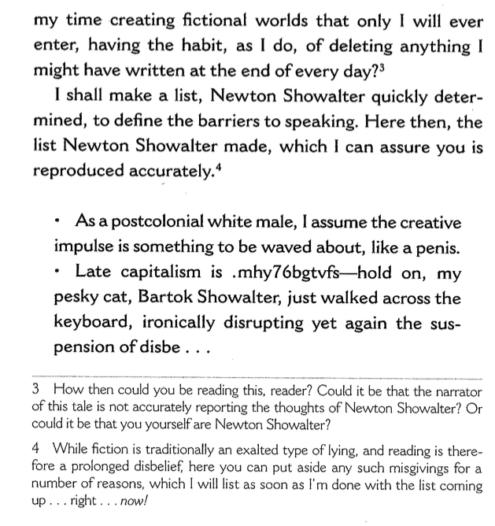
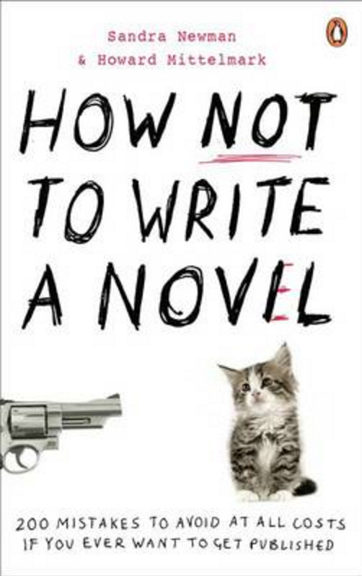
To Meta or Better Not?
(Newman & Mittelmark 2008: 236 – 237)

Slide 3
Good advice or stifling my creative vibe?
... postmodernism will be defined as any conscious
reference to the author as the author, the novel as
a novel, writing as little ink shapes on paper, or
anything else that underlines the artificial nature of
fiction.
It should be immediately obvious that all these
things are baldly inimical to the novelist’s goal of
writing a story that the reader can believe in.
Why then do people keep writing novels in which
the author is a character, bizarre footnotes intrude,
and typographic tricks remind us of the book as a
physical object, which might easily be shied at the
head of a smarty-pants writer? (p. 237)

Slide 4
Good advice or stifling my creative vibe?
Because, every year, someone gets away with it.
That person gets tons of extra credit because it is
really really hard to do well. Everybody says how
smart they are through teeth gritted with envy,
which is second only to boatloads of money as
they novelist’s greatest reward.
If you insist on going this route, betting double or
nothing, there is nothing we can say to help. All we
can do is let you get back to work. For you, there is
no point in reading the next section. (p. 238)

Slide 5
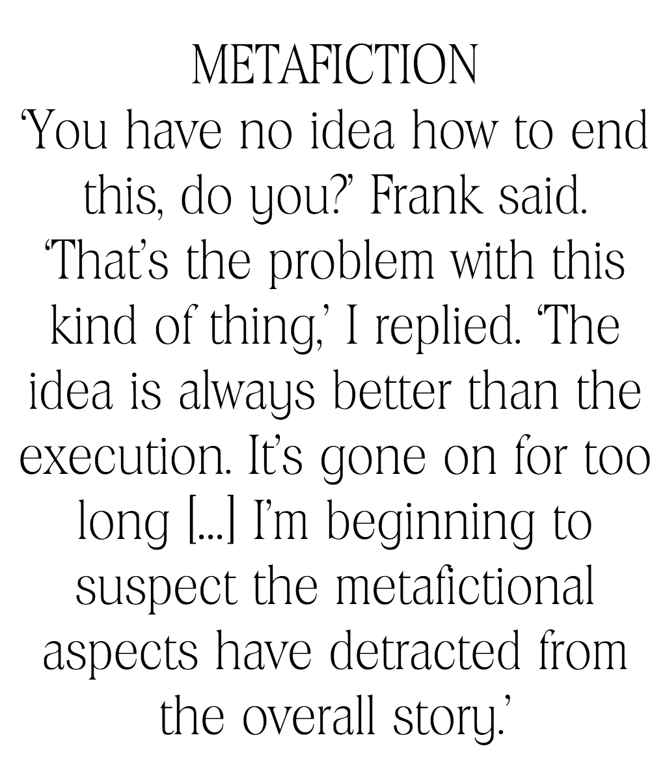
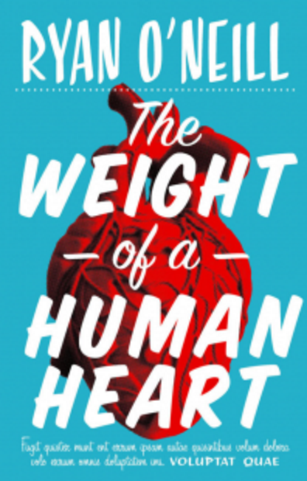
Yet There’s always a joker in the Pack

Slide 6
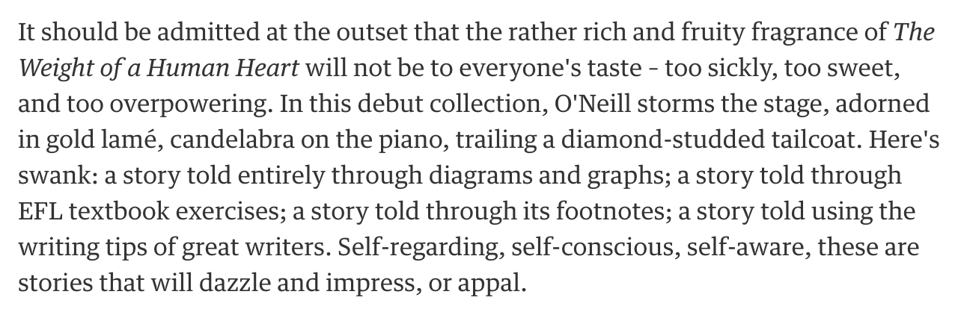
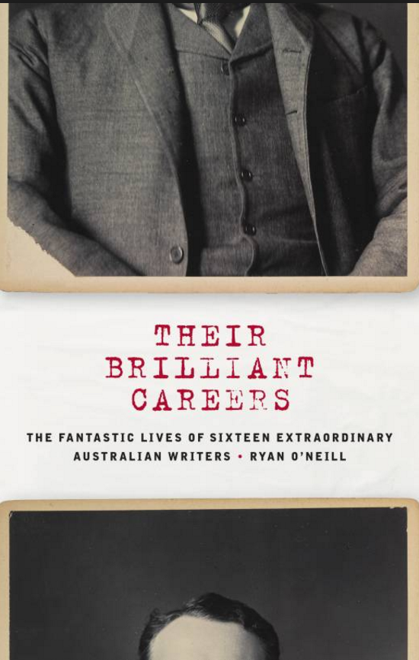

The joker in the pack

Slide 7
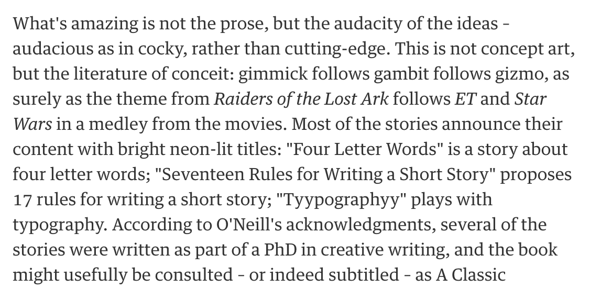
The joker in the pack
https://www.theguardian.com/books/2012/sep/07/weight-human-heart-ryan-oneill-review

Slide 8
Creative response
Authors of metafiction often violate narrative levels by intruding to comment on the writing, involving themselves with fictional characters, directly addressing the reader, or employing other techniques that reveal the work's fictional state. Using the Week 5 readings as a guide to these techniques, write a piece of metafictional flash fiction.
Suggested prompts:
1.) Consider how a character’s interaction with a text (including the text he/she
is being ‘written into)’ might change or alter the narrative they are in.
2.) Write a piece of flash fiction that attempts to imitate a particular literary
or narrative style you are familiar with (eg. The Victorian novel, the hard-boiled
detective novel (noir), while also openly acknowledging the narrative conventions
you are using or playing with, as well as its limitations. How subtle is your parody
or pastiche?
As the ‘author’ you could comment/show (overtly or subtly) your awareness of a
common plot device, the use of a cliché or a stock character, or even the difficulty
of being innovative or original in narrative.

Slide 9
Critical response
Describe how metafiction is used in any one of the readings from Week 5. What effect does the use of metafiction have on the narrative, and why might the author have chosen to use metafiction in this way?
Discuss the author’s use of one or more of these devices and the effect
that/those devices:
Self-reflexivity: addressing the reader directly as the author (breaking the fourth wall) in the narration
Other devices – eg. footnotes, graphs, typography
Intertextuality: referring/including other texts (real or fictional)
Parody and pastiche
Suggested questions/quotes for structuring your response:
‘Metafiction ... functions as a challenge to the assumptions behind literary
realism and ‘lays bare’ its own processes of construction to remind us that
reality is similarly constructed or mediated.’ (Nicol 2009: 99)

Slide 10
Critical response
Describe how metafiction is used in any one of the readings from Week 5. What effect does the use of metafiction have on the narrative, and why might the author have chosen to use metafiction in this way?
Suggested questions/quotes for structuring your response:
1.) How does the use of typography ‘lay bare’ its own processes of construction
in O’Neill’s ‘Tyypography’? How do O’Neill’s other two short stories ‘interact’ with
with ‘Tyypography’ (intertextuality, self-reflexivity) to ‘remind us that reality is
similarly constructed or mediated.’ How does this ‘destabilise’ the narrative?
2.) Footnotes are often used in postmodern or metafictional works. What effect
does William’s use of footnotes in Cockaraco have? How do they function as a
metafictional device?
3.) What metafictional devices does Calvino use to consciously engage the reader
in the process of reading and writing? How does Calvino’s involvement of the ‘you’
(the reader) as a protagonist ‘peel back the layers’ of the novel’s construction from
both the writer’s and reader’s POV?
Nicol, B 2009 The Cambridge Introduction to Postmodern Fiction, Cambridge University Press, New York.

Slide 11
A Good Critical Response...
Uses and ‘unpacks’ textual evidence. This means citing directly from the primary
text to demonstrate or ‘prove’ your claims about the text, then explaining how that
quote or chunk of text does what you say it does. The link between your claim and
your evidence of that claim should be explicit. A ‘For example,’ is sometimes all
that’s needed, other times you may need to pull apart the quote in more detail.
Is clearly expressed and uses plain, unadorned language. This includes:
Using the active voice and avoiding excess or unnecessary words (verbiage). For example, ‘Carver makes much use of omission throughout his story ‘Why Don’t You Dance?...’ Instead write, ‘ Carver uses omission in his ...’
Ensuring sentences are grammatically correct. Common issues in this regard are: subject/verb agreement, muddled syntax (word order), incorrect use of punctuation (eg. joining too many clauses with a comma instead of starting a new sentence), sentences that are too long and which therefore ‘break’ in the
middle, fragment or incomplete sentences (sentences without a qualifying
clause).
Odd or incorrect word choice that alters the intended meaning

Slide 12
A Good Critical Response...
Analyses, not appraises a text. Avoid judging whether a story is successful, clever, or
whether an an author has ‘expertly applied’. This means avoiding adverbs such
as expertly, skillfully, beautifully, cleverly – these words belong in a book review, not
in a critical/academic critique. You are describing and explaining HOW an author
has achieved a certain effect. That is, by what means or narrative technique (eg.
omission, parataxis, voice, word choice, characterisation, figurative allusion, etc.)
does Carver/Byatt/Walker/Paluhniuck achieve what you’re claiming they do.
Avoids platitudes and meaningless statements. For example, ‘Minimalism is very
important technique for writing.’ This is a platitude, not critical analysis. It neither
explains either ‘why’ minimalism is important, what minimalism is or what its
effects are.
Integrates scholarly quotes or references into the argument. A quote from a
secondary source needs to be unpacked (explained) and explicitly linked to the
examples you choice from your primary text. Avoid ‘standalone’ quotes and tacking
a quote to the end of response.

Slide 13
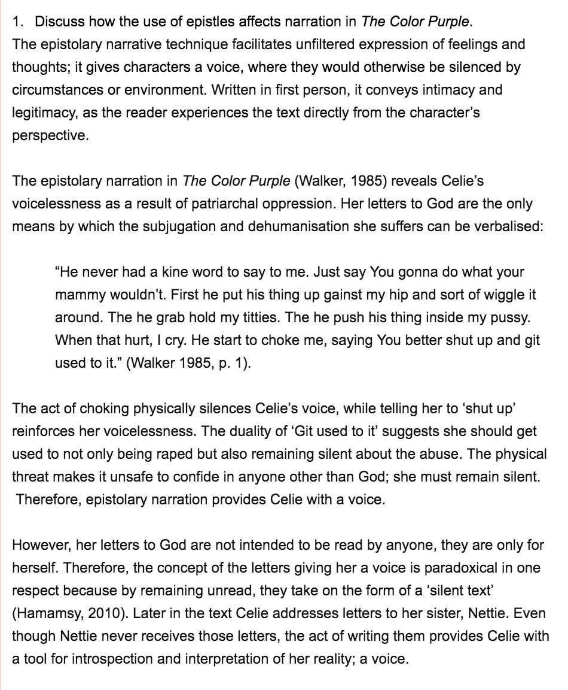
An Excellent Critical Response

Slide 14
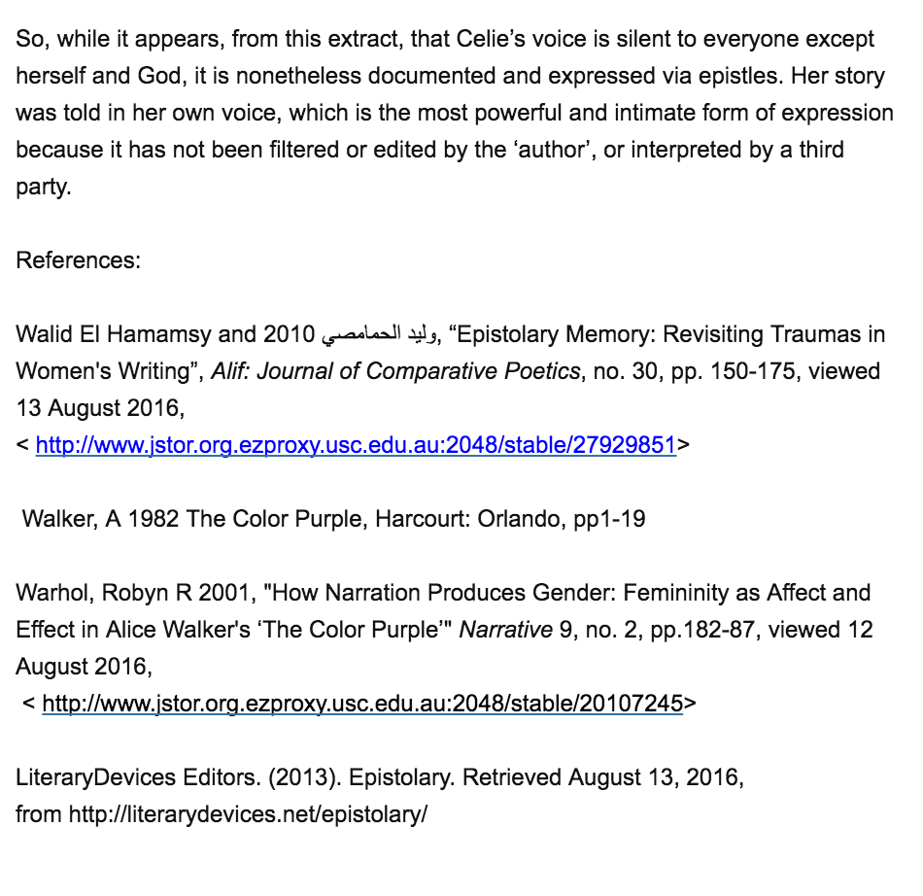
An Excellent Critical Response

Slide 15
Critical Responses: Referencing & Formatting
12pt Times New Roman Font, double-line spacing
For short story titles use single quotation marks, eg. ‘Why Don’t You Dance?’ and for book titles use italics, eg. Slaughterhouse 5
No paragraph indenting
Each paragraph is separated by a double line break (press ‘Enter’ twice)
Quotes four lines or more must be block quoted (new paragraph,
indented, 11pt font, 1.5 spacing)
Punctuation resides outside quotation marks and after in-text referencing
for quotes. Eg. In The Art of Fiction, Lodge states that a beginning is
‘a threshold’ (1992: 5).
Harvard Referencing -- for in-text referencing and reference list formatting see Harvard Referencing Guide (in-text page numbers are essential for direct quotes and desirable/preferred for paraphrasing)
Be sure to include a reference list that includes primary texts as well as
scholarly or academic references

Slide 16
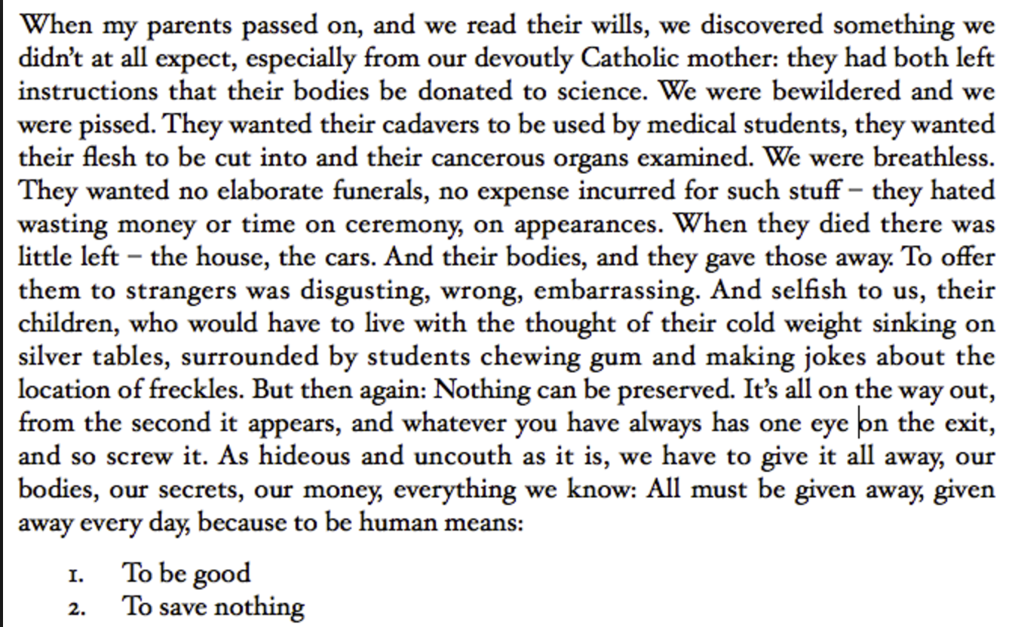
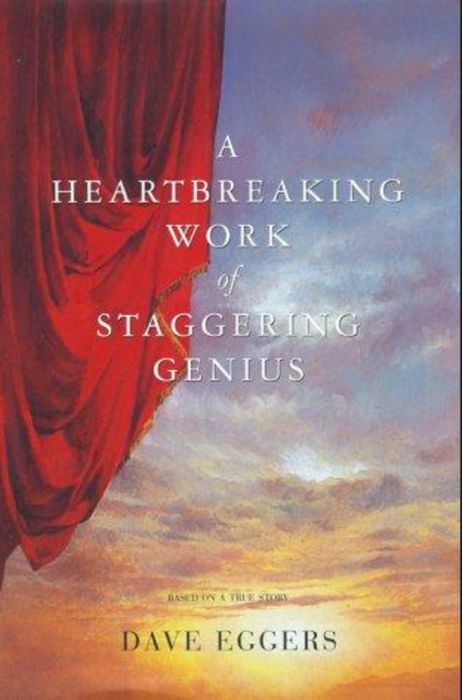

David Eggers’s A Heartbreaking work of staggering genius
(2000)

